Slide 1
Analytic Tennis
Let’s start the journey of improvement

Slide 2
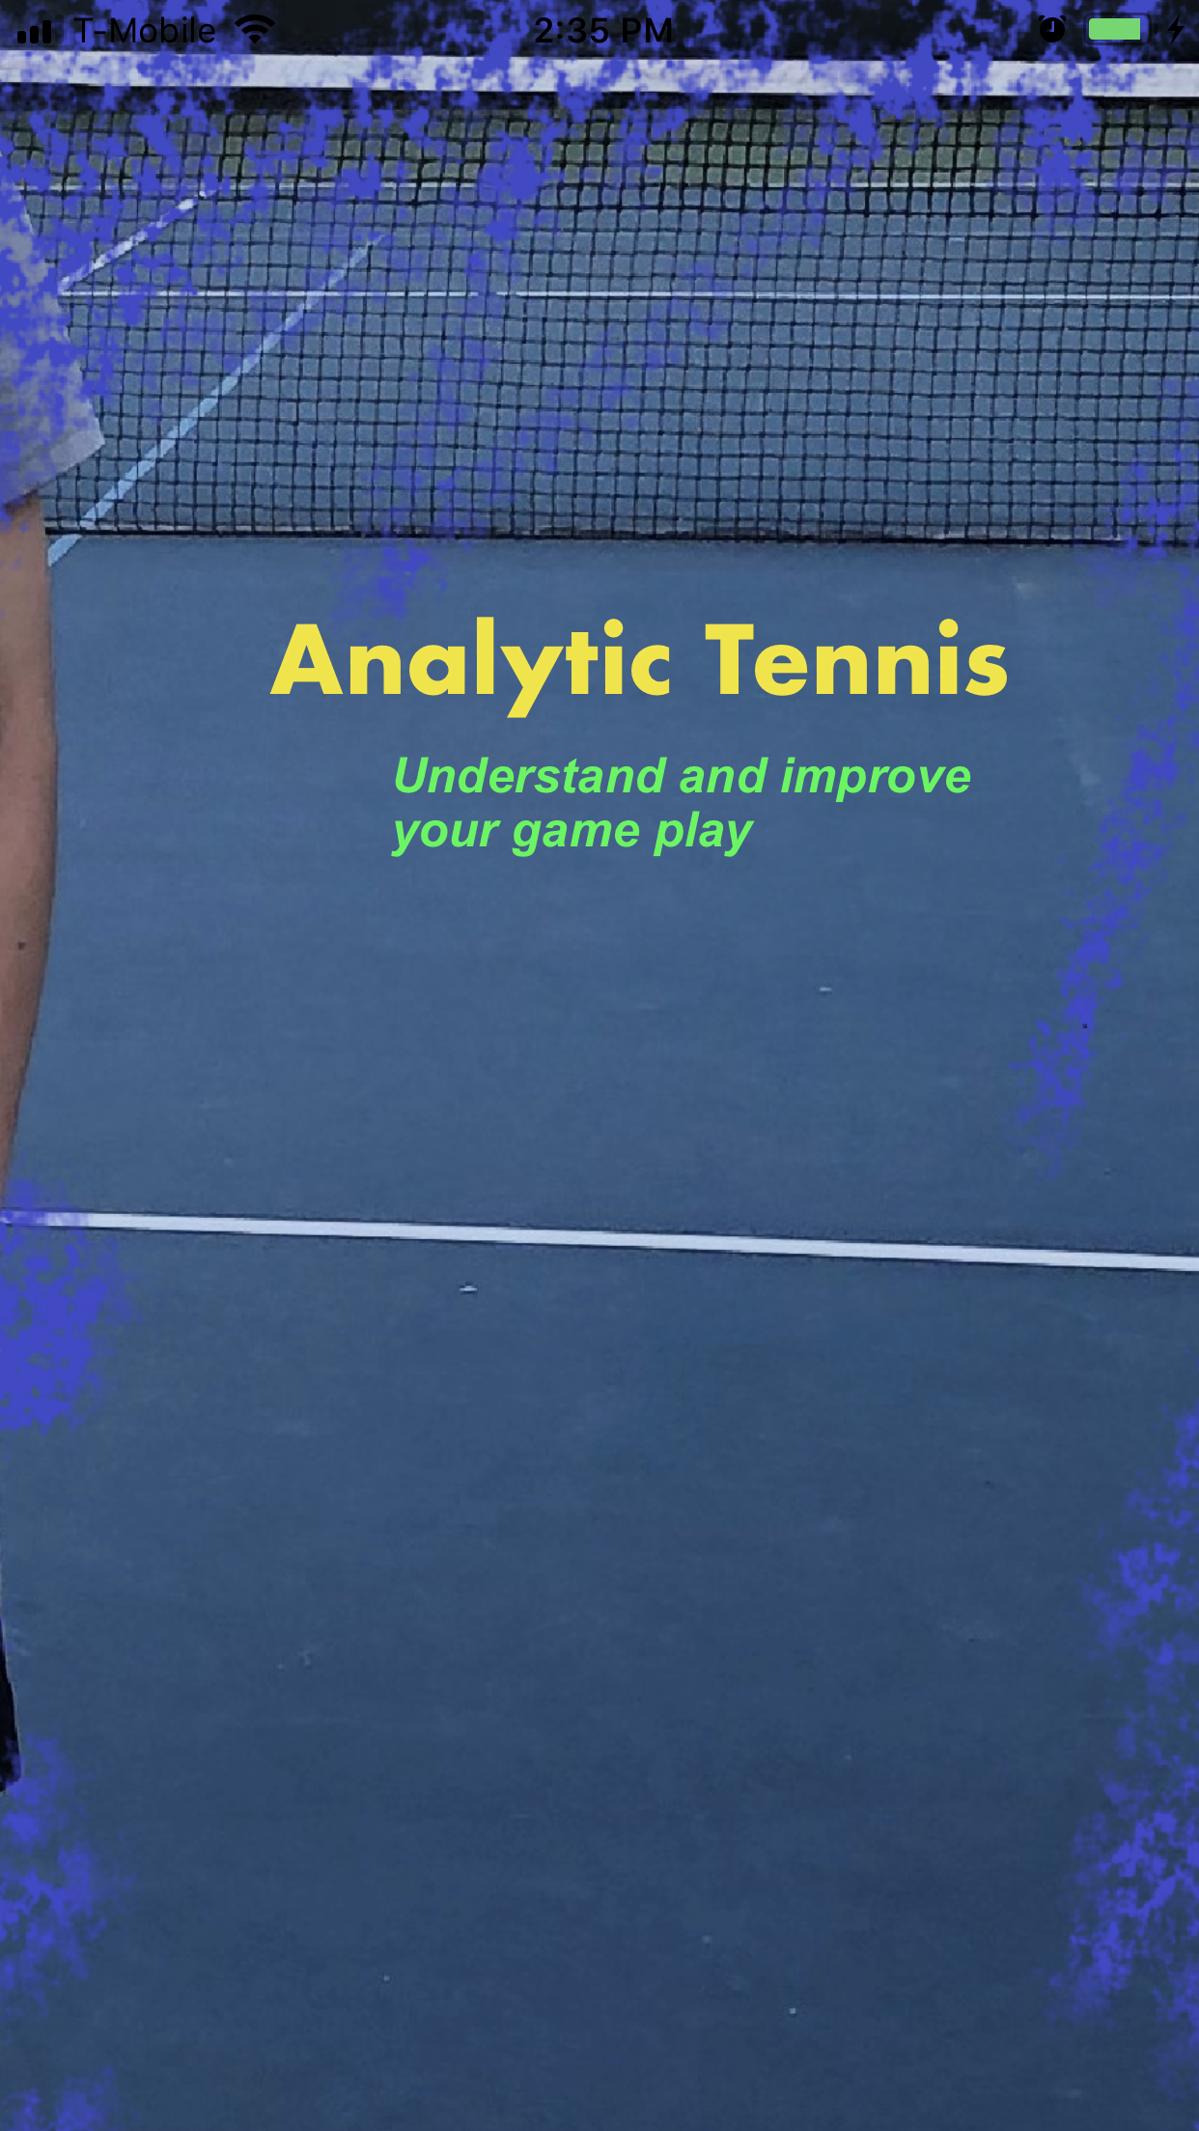
Welcome to Analytic Tennis
Let’s start your journey of the improvement.
First, let’s start Analytic Tennis.

Slide 3
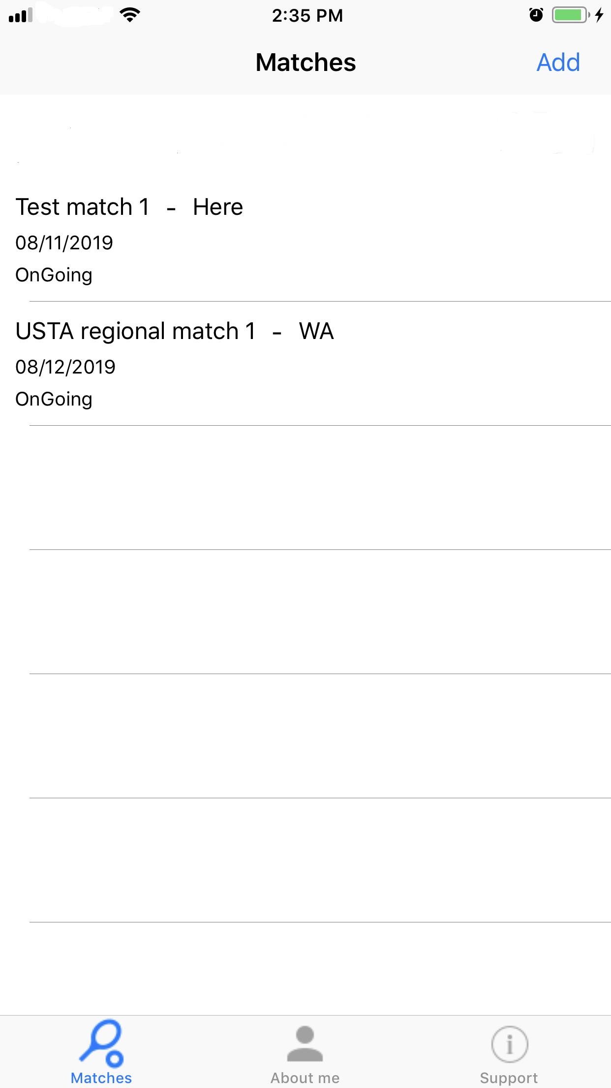
On the main screen, you can see 3 different tabs.
First tab is for adding and reviewing matches.
2nd tab is to set you or your player information.
3rd tab is to get the support.

Slide 4
If you want to add a new match, tap on “Add” on top right corner.
If you want to review or add more point info to any existing match, select one of existing matches in the list.

Slide 5
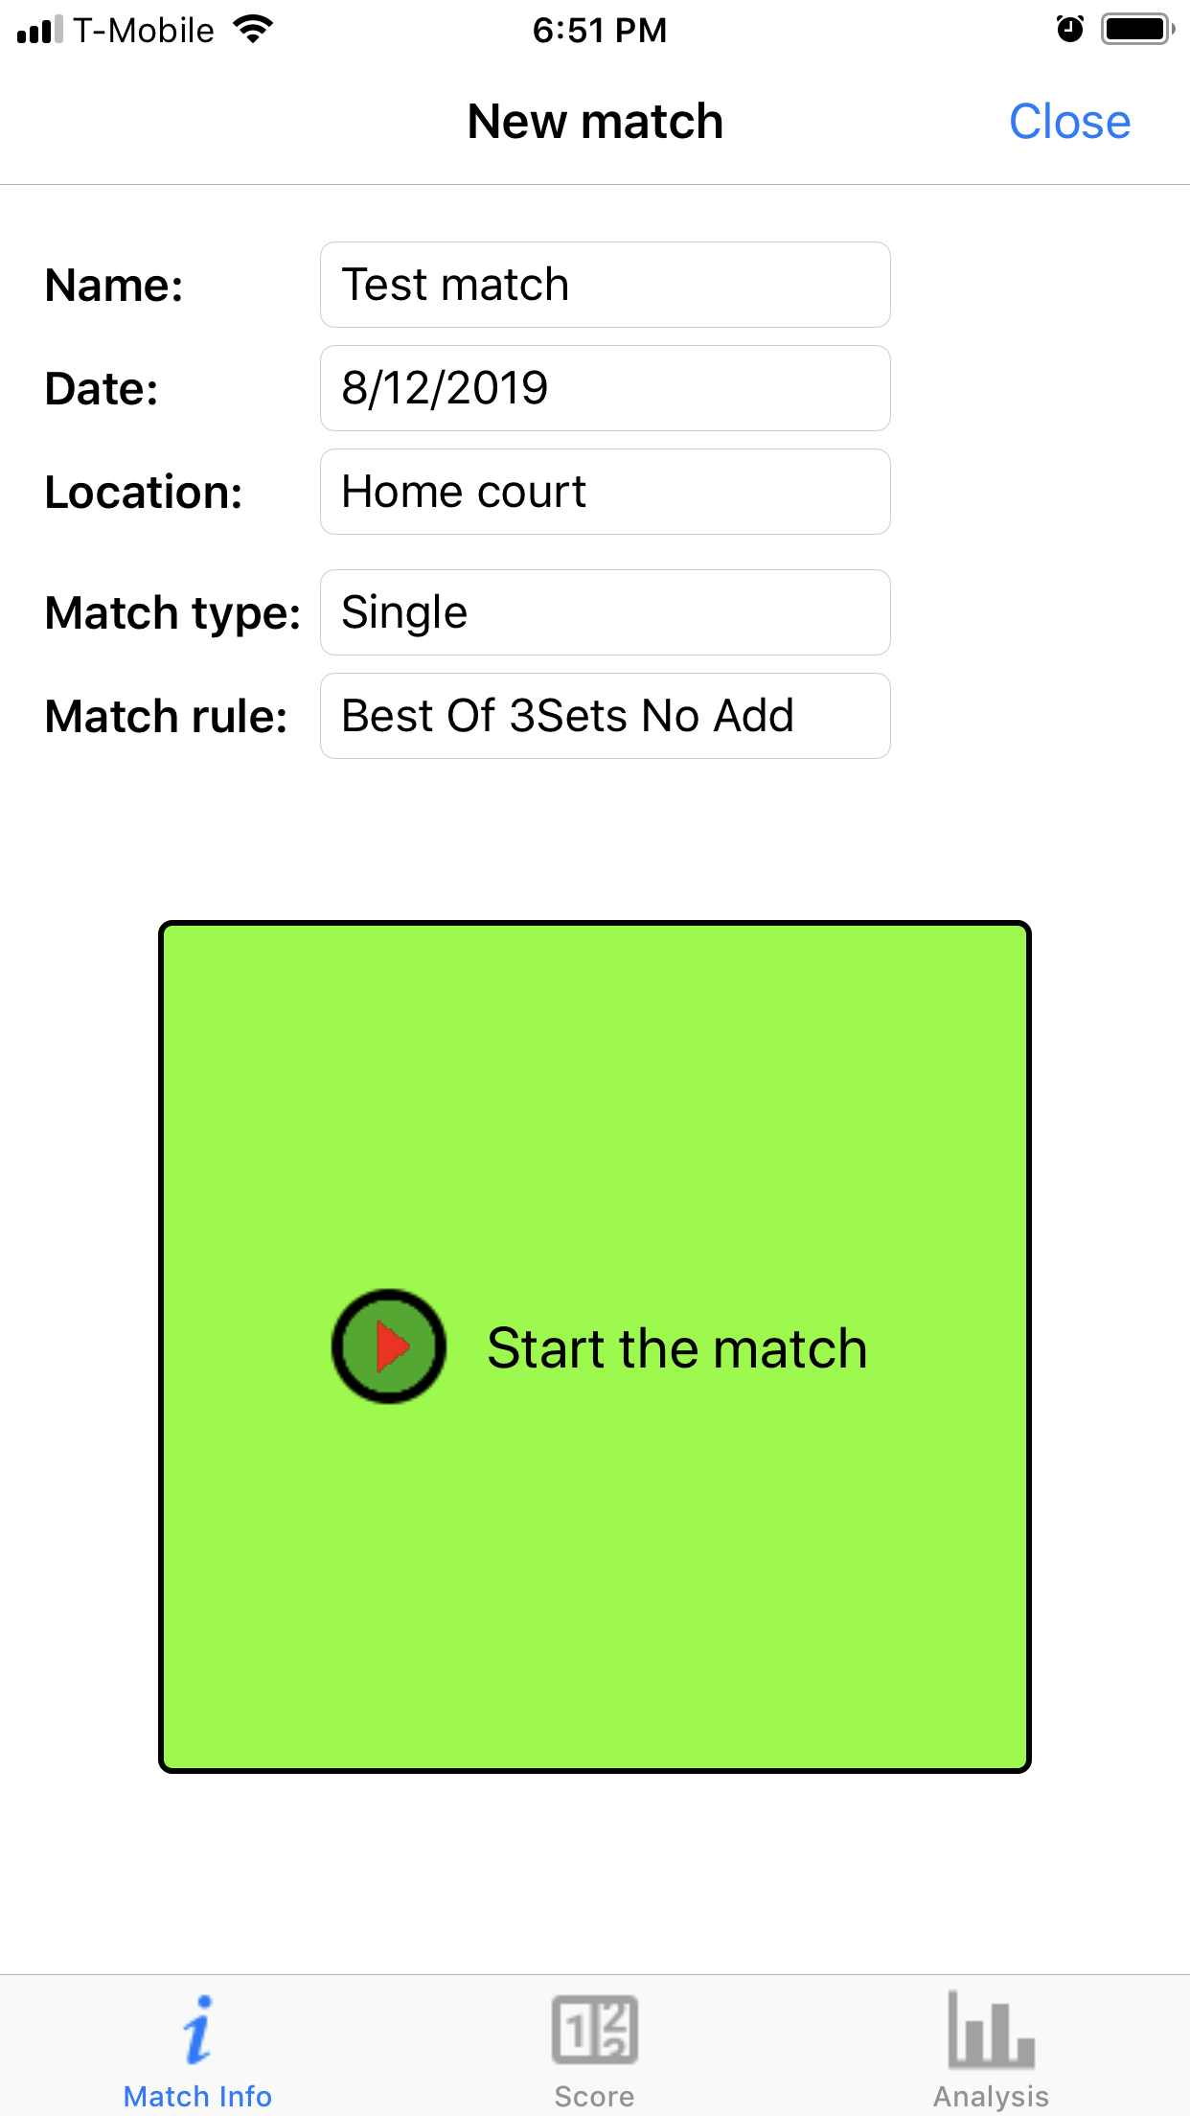
Here is how to start a new match record.
Enter a name of the match like “Test match”
Enter the location of the match like “Home court”
Select a type of match rule
Press “Start the match” button.

Slide 6
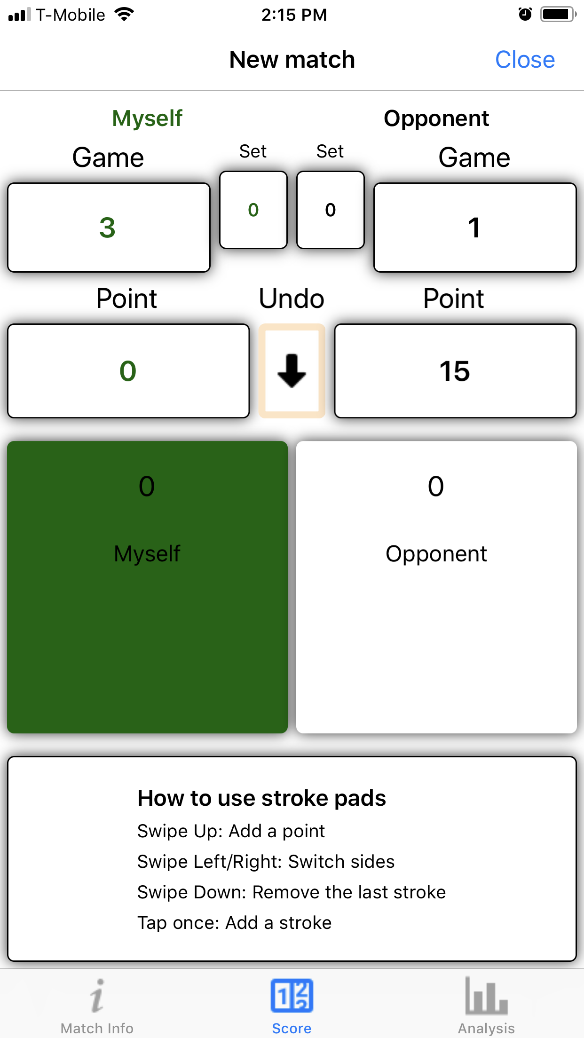
Now, a match starts. Let’s enter match data.
First Green color is my player. The other player(Opponent) is shown in black.
Tennis play is based on exchanging strokes between two sides.
Based on the strokes and how the ball stops, a point is given to either side.
A single tap means a stroke by a player and swipe “Up” is for a point won by a player.
Stroke pads

Slide 7
How to give a point to a side.
1st Service Ace by Opponent:
Tap once on the stroke pad of Opponent
Swipe “Up” on the Opponent pad

Slide 8
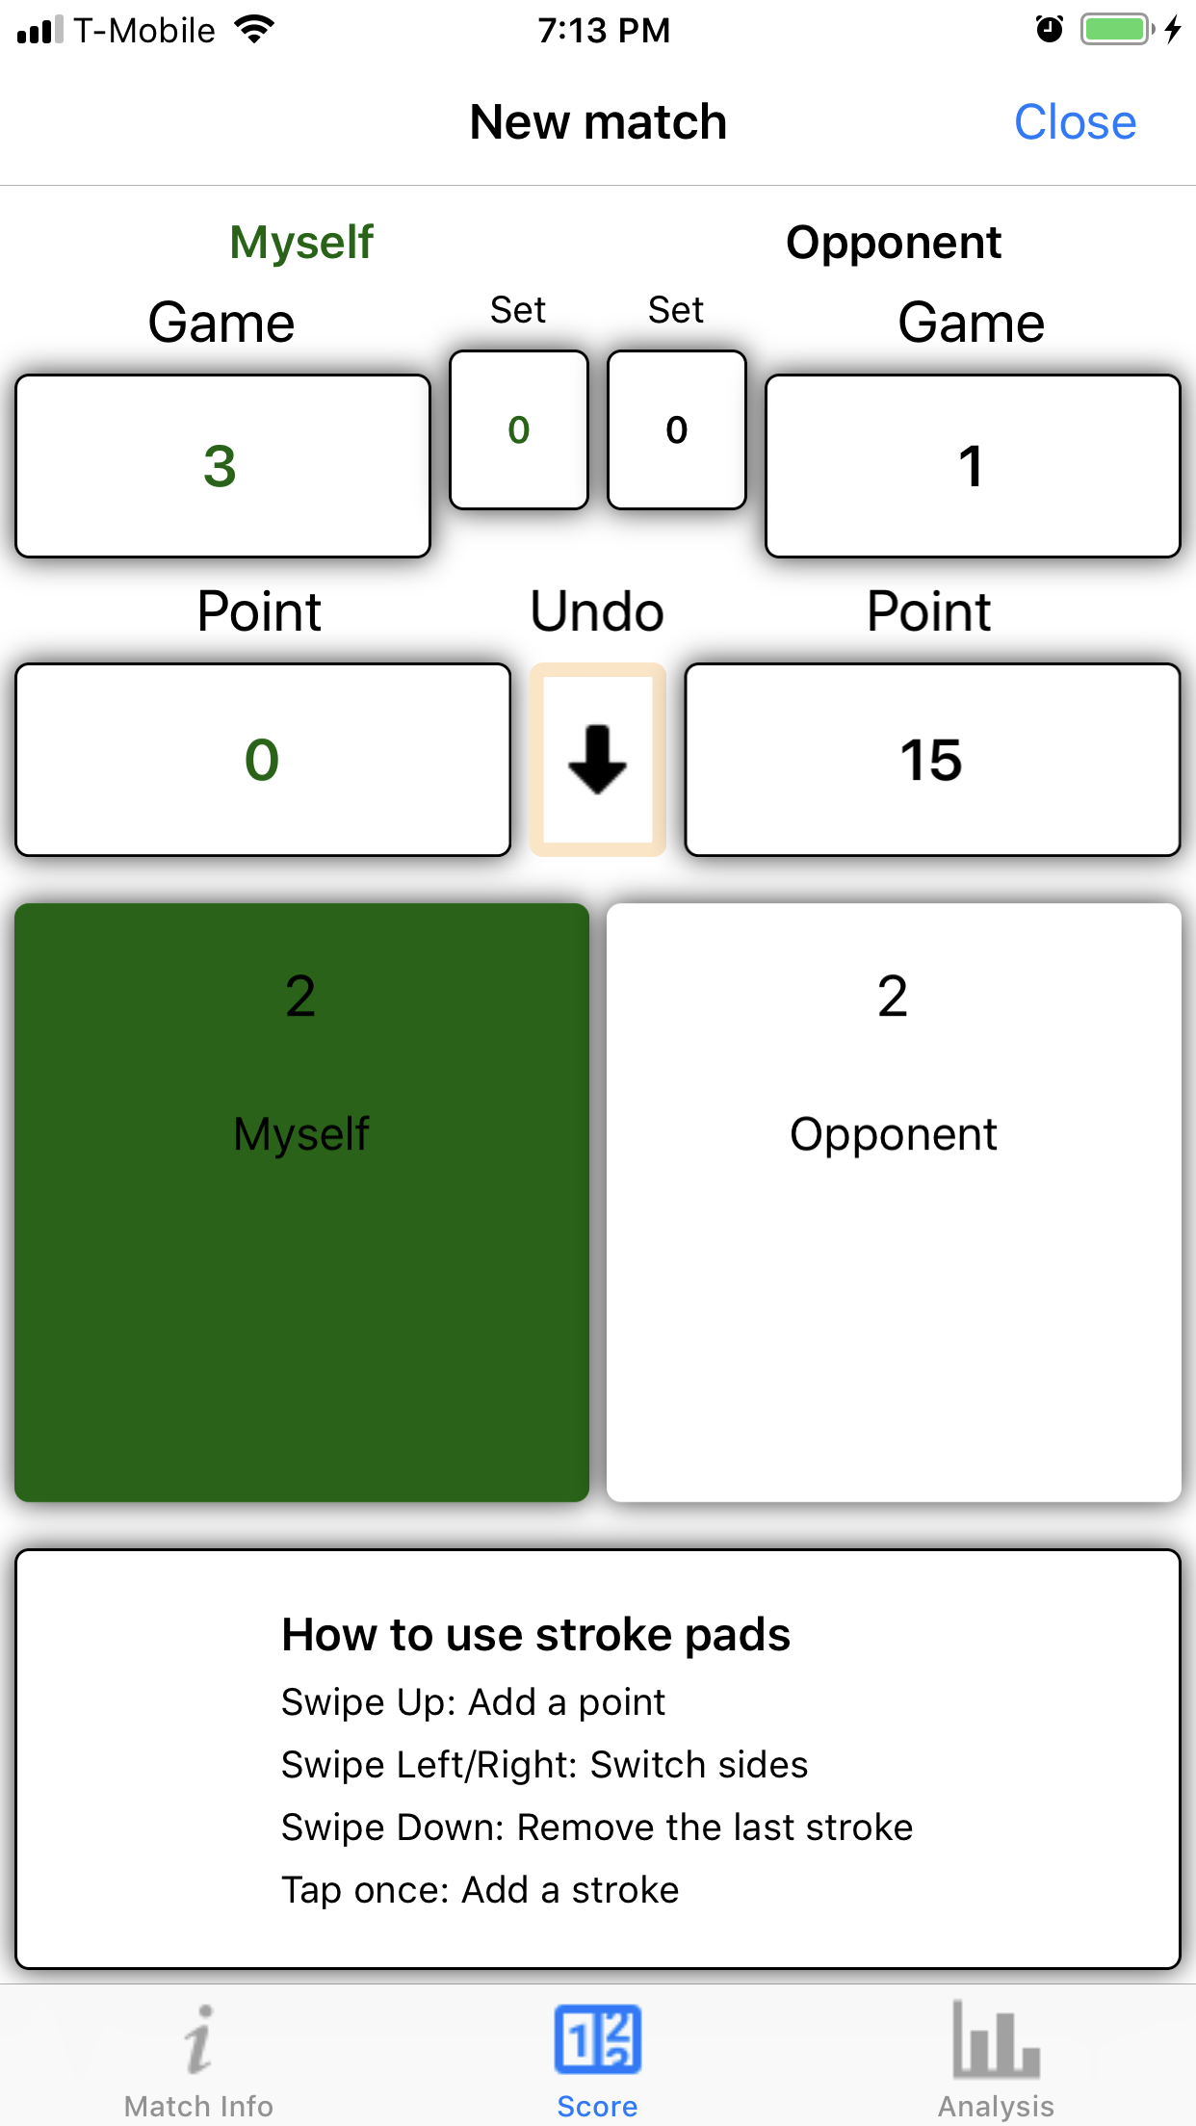
How to give a point to a side.
4 stroke rally and home won by home
Tap once on the stroke pad of Opponent (Opponent serves)
Tap once on the stroke pad of Myself
Tap on the Opponent pad
Tap on the Myself pad
**the picture reflects step 4.
Swipe “Up” on the Myself pad
(My player win a point)

Slide 9
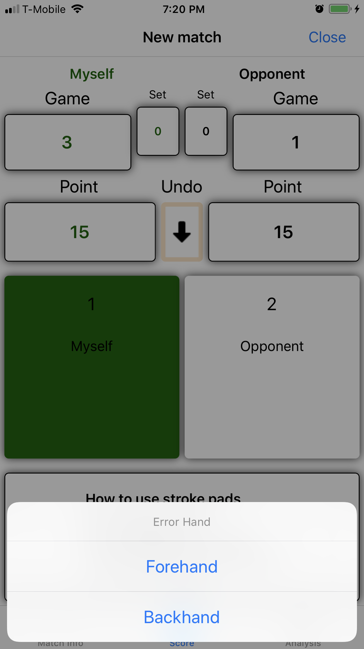
An error was made by the opponent during a point.
Tap once on the stroke pad of Opponent (Opponent serves)
Tap once on the stroke pad of Myself
Tap on the Opponent pad
Opponent makes an error stroke to give a point to my player.
Swipe “Up” on the Myself pad
Select a hand side of Opponent’s last stroke
**select “forehand”

Slide 10
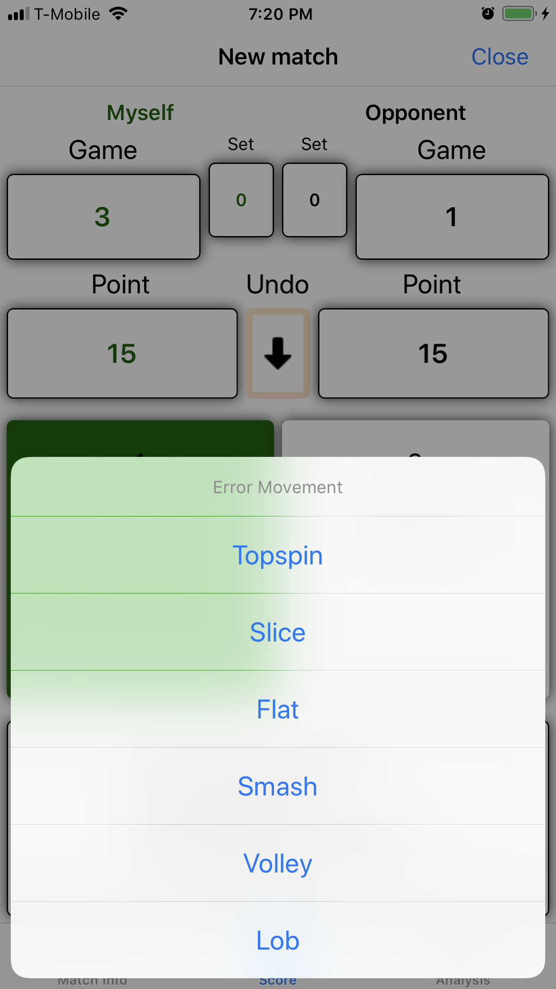
An error was made by the opponent during a point.(Continued..)
Select a movement
**select “Slice”

Slide 11
If a point is added to a wrong side, how to correct.
Once a point is added to a side, before starting a point play by adding a stroke, you have a chance to correct it by pressing “Undo” button.
Once you press “Undo” button, the last point is removed and the last point play is restored back to stroke pad.
You can correct strokes and give the point to a right side.

Slide 12
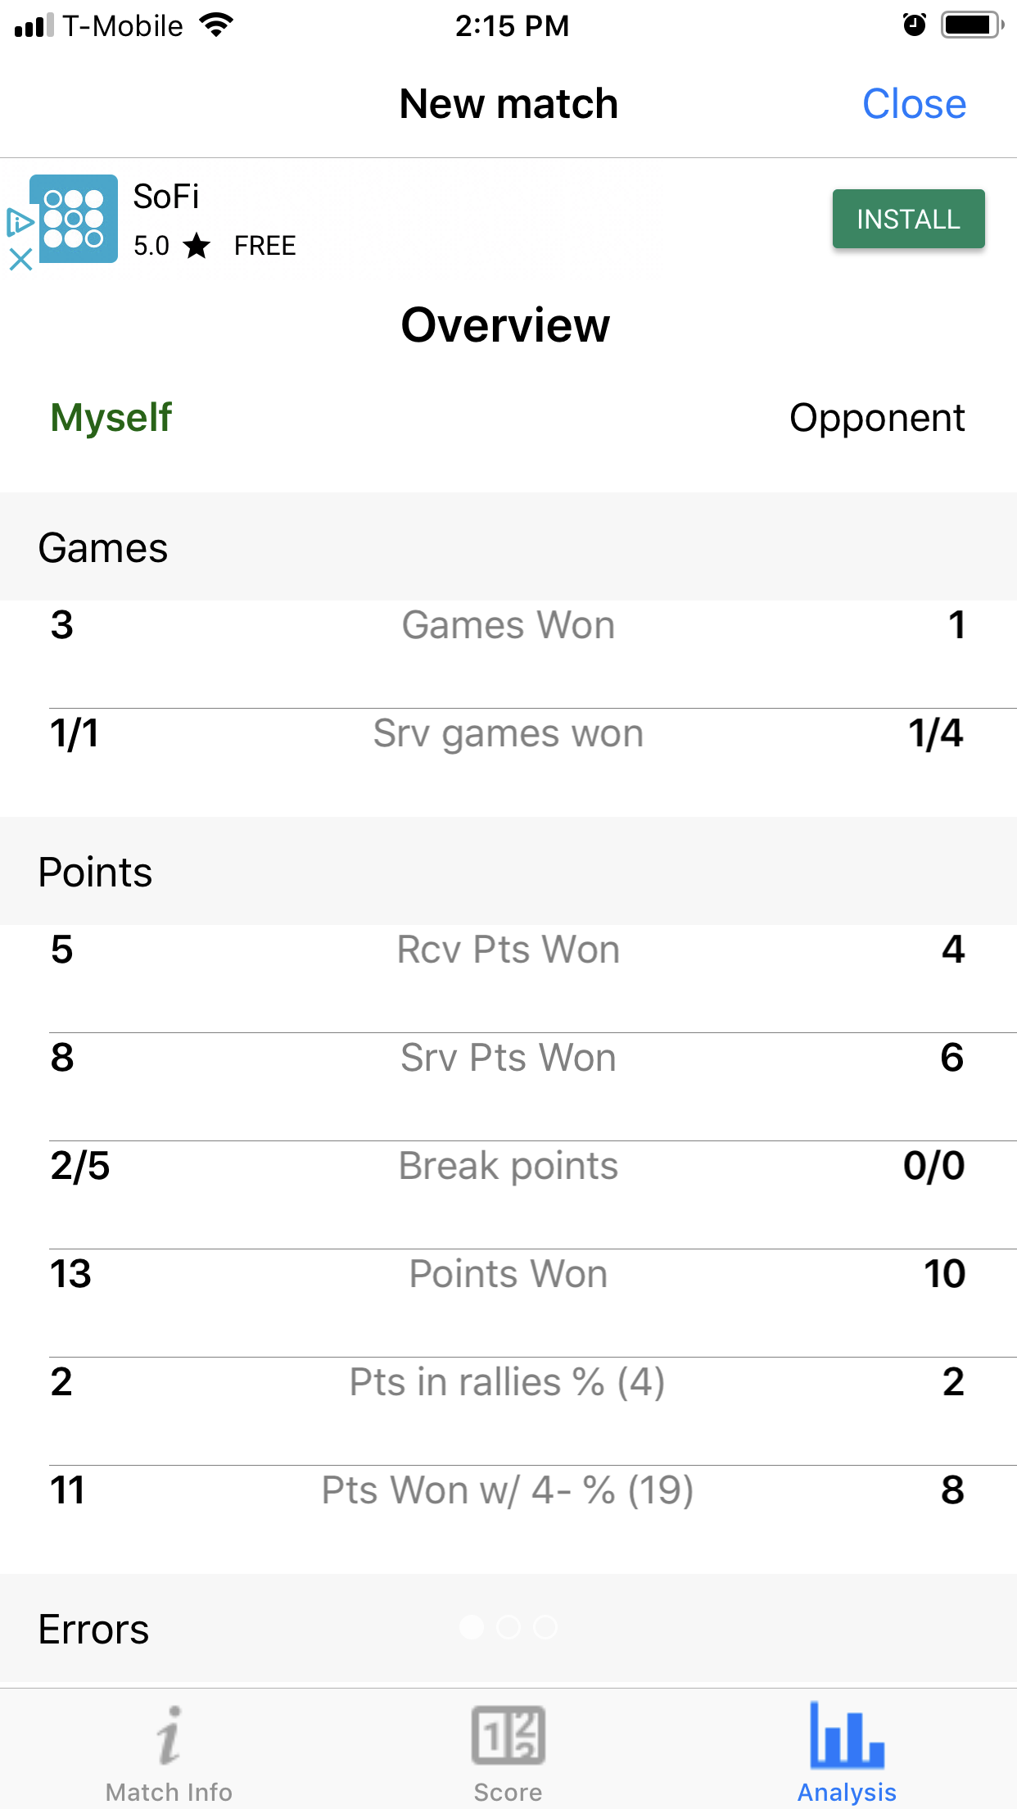
Analyze the match with current data.
While a match is going on, if you tap on “Analyze” tab, you may see the analysis of the match with the current point and game data.
The next picture is “Overview” example.

Slide 13
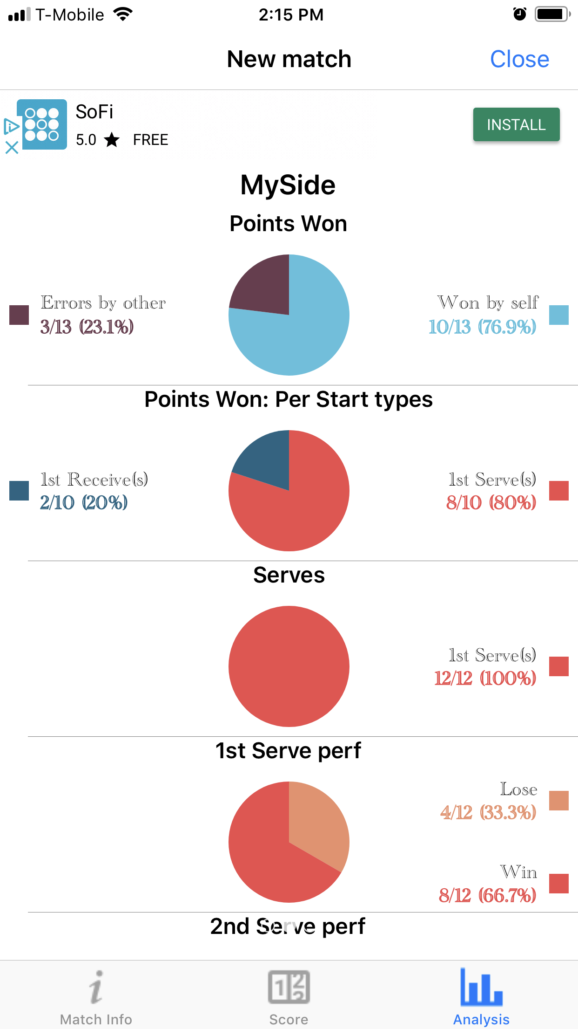
Analyze the match with current data.
(Continued..)
If you swipe the analysis carousel, you may see “My player” or Opponent overview analysis.

